Slide 1

Lecture 8 Finding More Shapes
COMP3204 & COMP6223 Computer Vision
How can we go from conic sections to general shapes?
 | Book pp 250-258; 271-279

Slide 2

Hough Transform for Circles
Again, it’s duality:
Points: parameters radius
Points: parameters radius

Slide 3
Circle Voting and Accumulator Space

Slide 4
Speeding it up…..
Now it’s a 3D accumulator, fast algorithms are available
E.g. by differentiation
So edge gradient direction can be used, e.g. 2D accumulator by

Slide 5
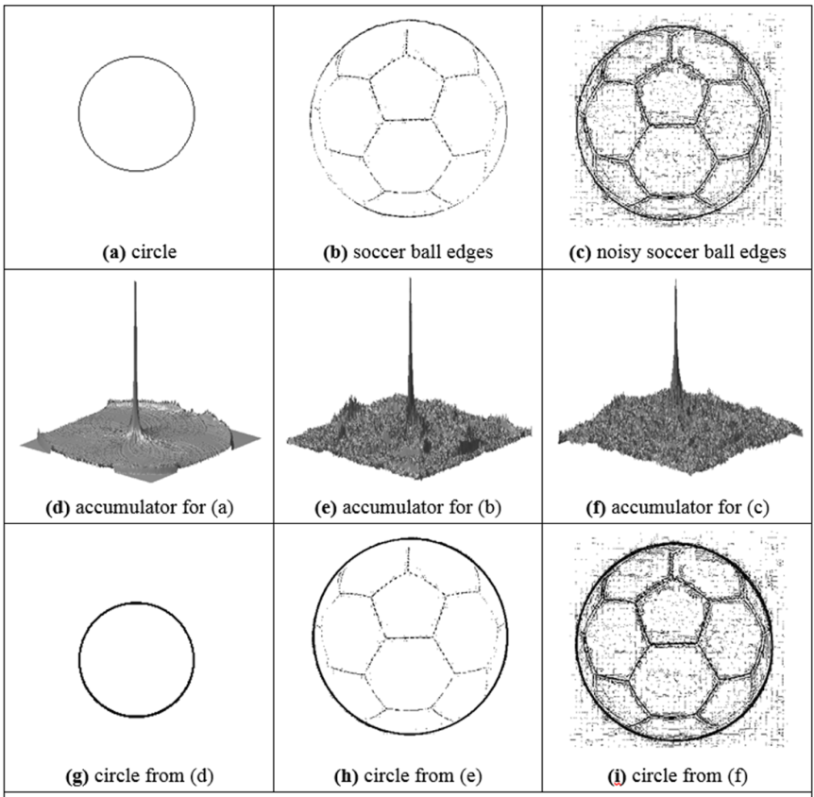
Applying the HT for circles

Slide 6
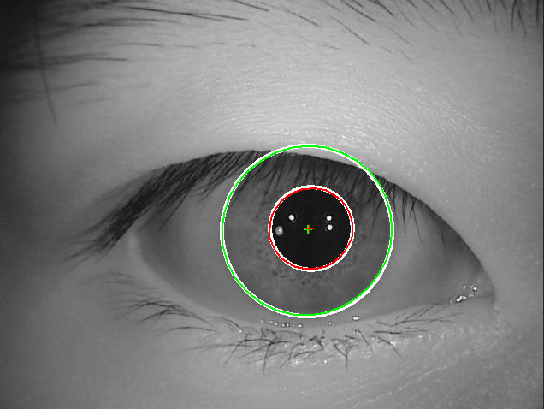
Integrodifferential operator?
https://stackoverflow.com/questions/27058057/comparing-irises-images-with-opencv

Slide 7
Arbitrary Shapes
Use Generalised HT
Form (discrete) look-up-table (R-table)
Vote via look-up-table
Orientation? Rotate R-table voting
Scale? scale R-table voting
Inherent problems with discretisation

Slide 8
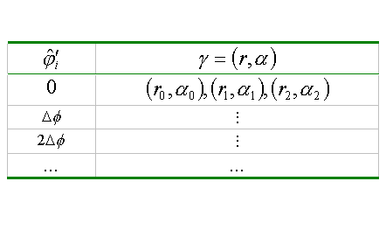
R-table Construction

Slide 9




Active Contours
For unknown arbitrary shapes: extract by evolution
Elastic band analogy
Balloon analogy
Discrete vs. continuous
Volcanoes?

Slide 10
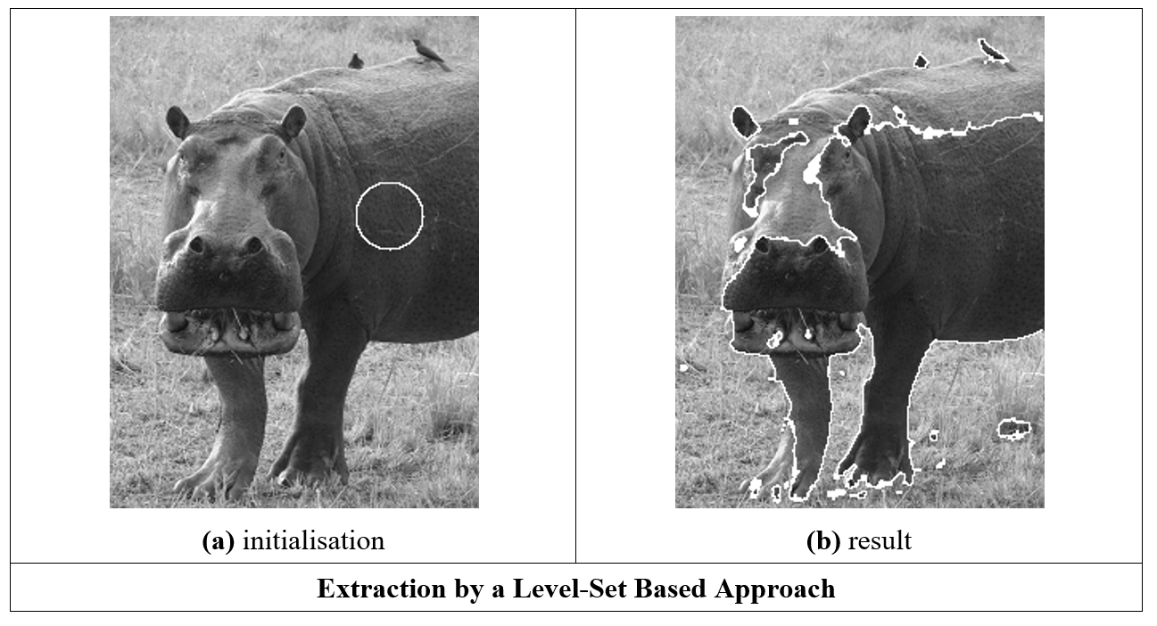
Geometric active contours

Slide 11
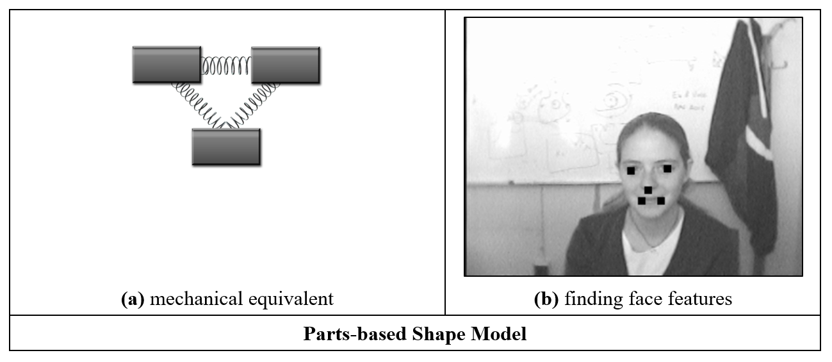
Parts

Slide 12
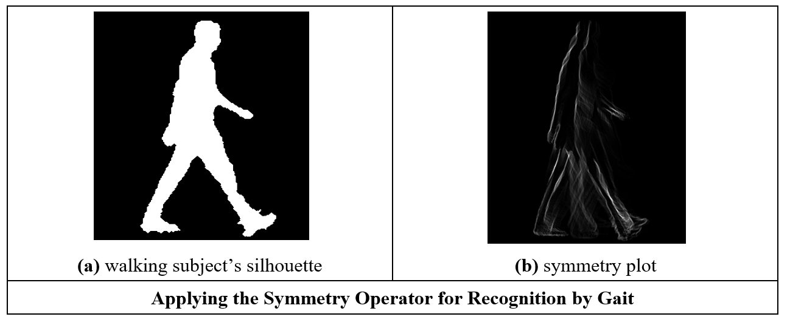
Symmetry

